Slide 1
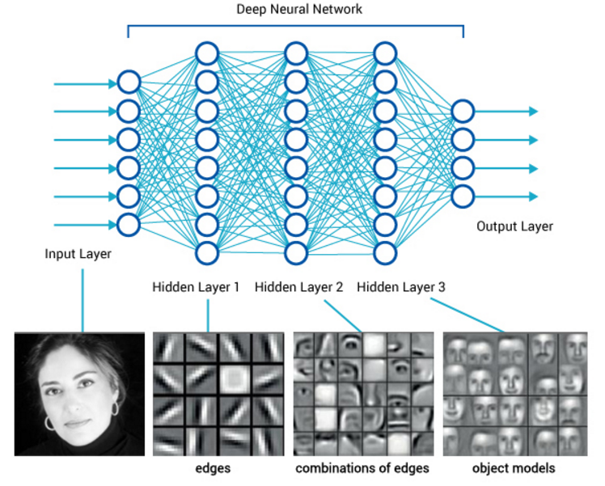
Deep Feedforward Neural Network

Slide 2
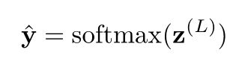
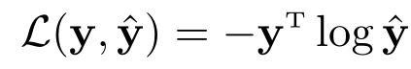
Parameter Learning
For multi-classification problems
If Softmax regression classifier is used, it is equivalent to setting C neurons in the last layer, and its output is conditional probability of each class after being normalized by Softmax function.
Using the cross entropy loss function, for the sample (x,y), the loss function is
Notes:
Softmax可看作一种特殊的激活函数。
y\in{0,1}^C

Slide 3
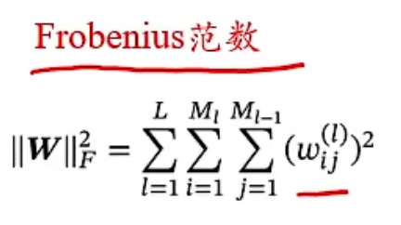
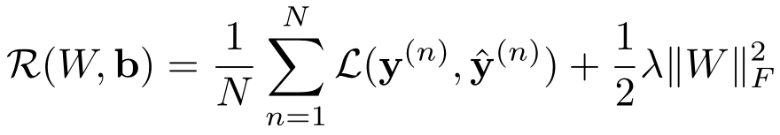
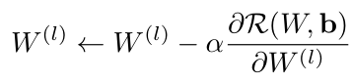
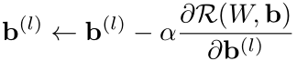
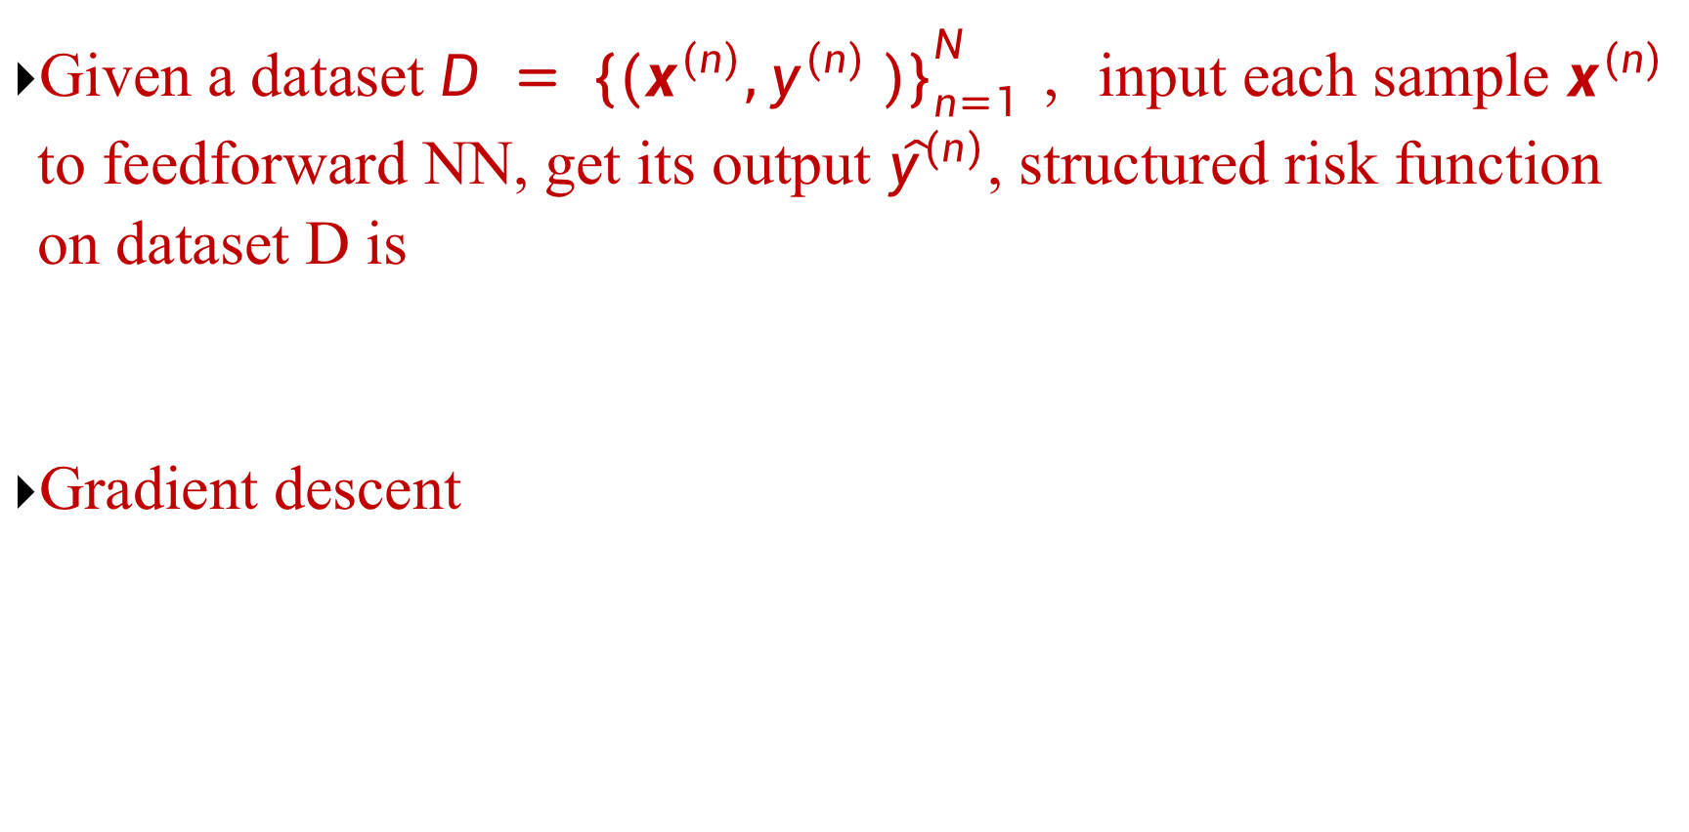
Parameter Learning
Given a dataset $D = {\{(x^{(n)},y^{(n)} )\}}_{n=1}^{N }$ ，input each sample $x^{(n)}$ to feedforward NN, get its output ${\hat{y}}^{(n)}$, structured risk function on dataset D is
Gradient descent

Slide 4
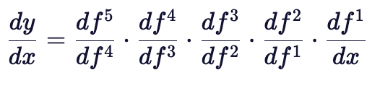
How to calculate the gradient?
Neural network is a complex compound function.
Chain rule**(important!)
Back propagation algorithm**(important!)
An efficient method designed according to the characteristics of feedforward network
$y=f5(f4(f3(f2(f1\left(x\right)))))$ → $\frac{∂y}{∂x}=\frac{∂f1}{∂x}\frac{∂f2}{∂f1}\frac{∂f3}{∂f2}\frac{∂f4}{∂f3}\frac{∂f5}{∂f4}$
We prefer to write from outside → inside

Slide 5
6.4 Back Propagation

Slide 6
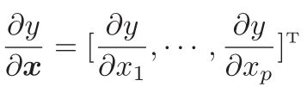
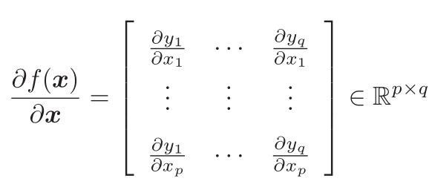
Matrix Calculus
An expression of multivariate calculus: using matrices and vectors to represent partial derivatives of each component of the dependent variable w.r.t each component of the independent variable.
Denominator Layout (Column Vector)
Partial derivative of scalar with respect to vector
Partial derivative of vector with respect to vector

Slide 7
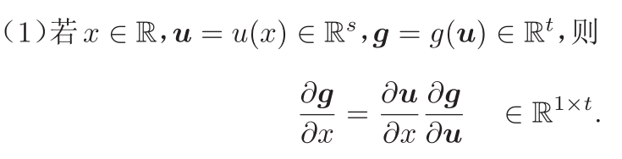
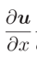
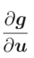
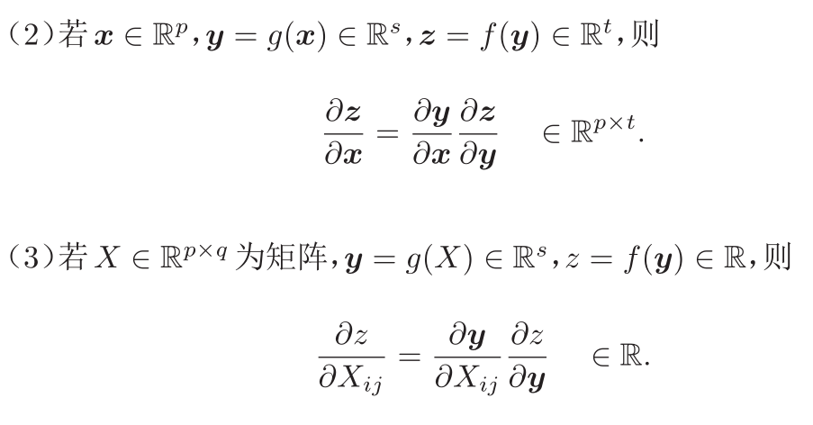
Chain rule*
Chain Rule is a common method to find the derivative of compound function in calculus.
What’s the dimension of

Slide 8
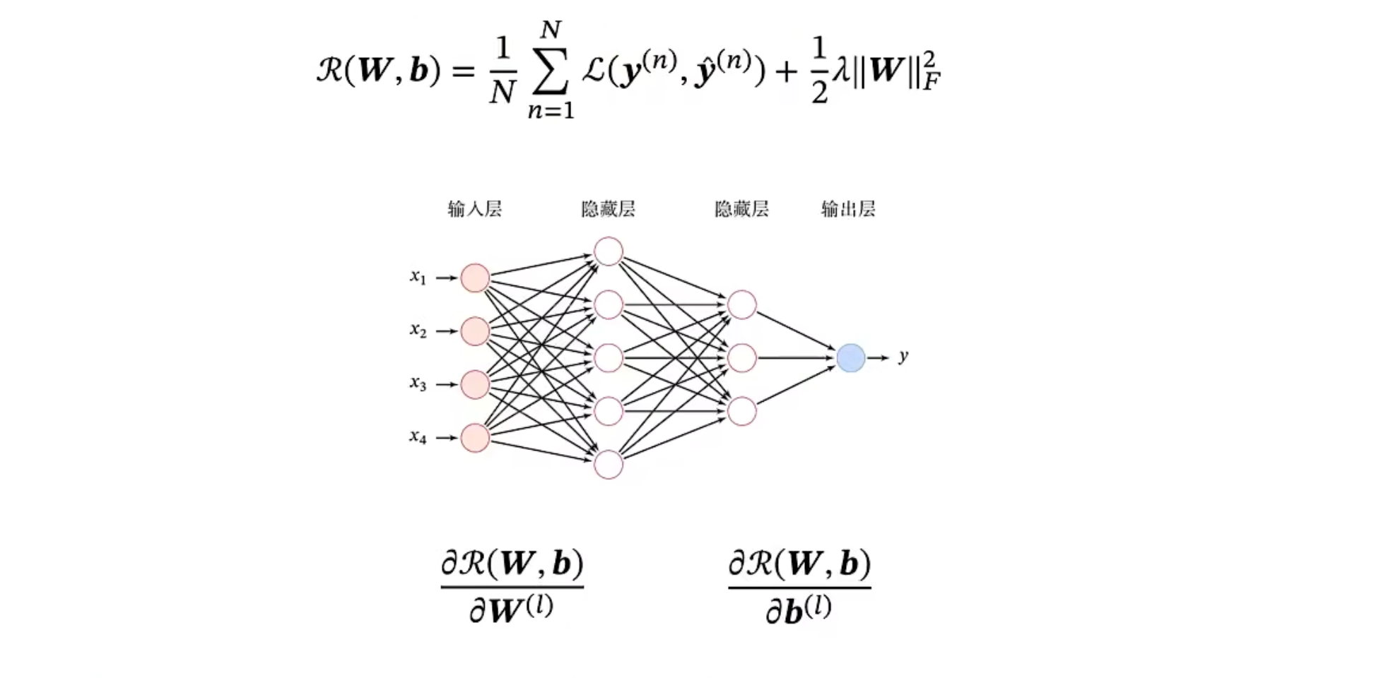
Compute Gradient

Slide 9
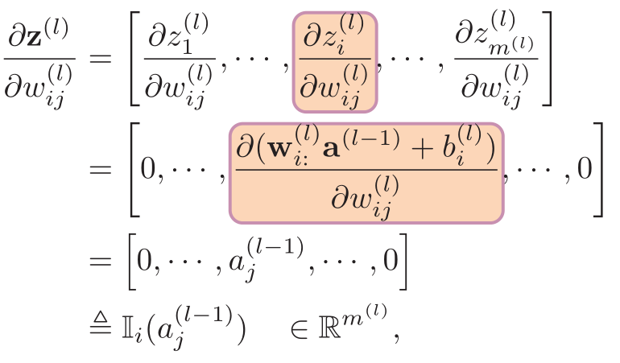
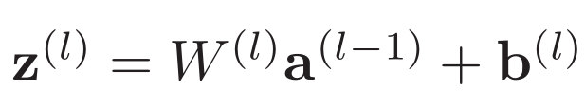
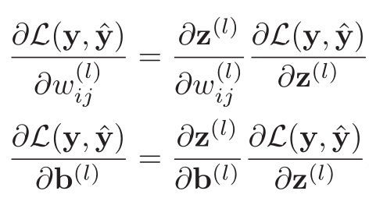
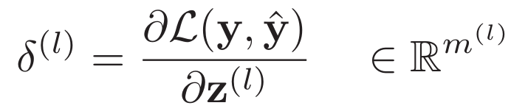
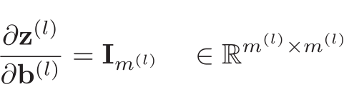
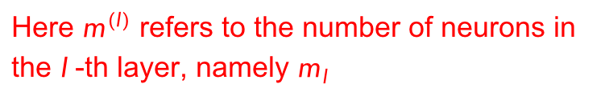

Compute Gradient
$$ℝ^{1×M_{l}}$$
Error term
Here $m^{(l)}$ refers to the number of neurons in the $l$-th layer, namely $m_{l}$

Slide 10
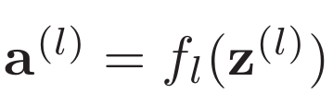
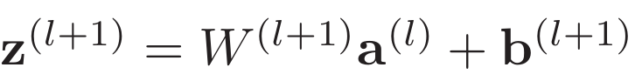
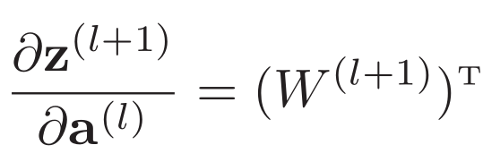
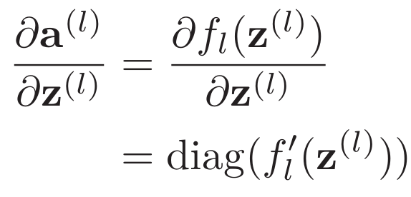
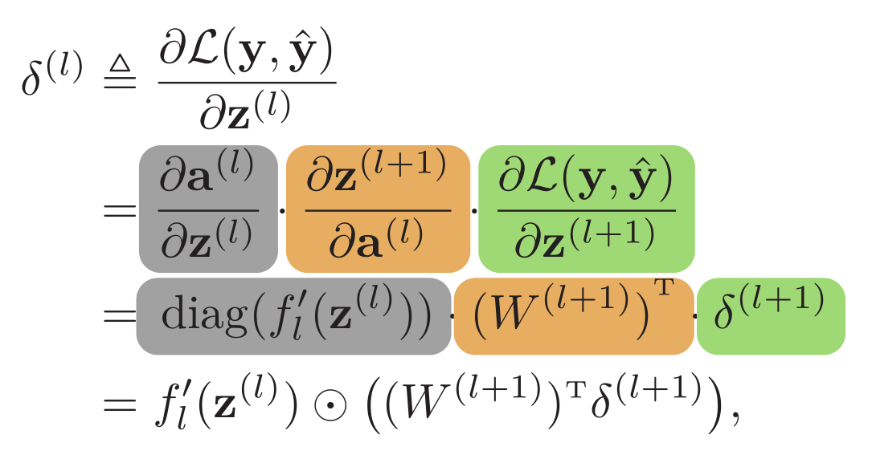


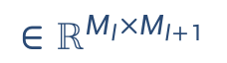
Compute
$$∈ℝ^{M_{l}×M_{l+1}}$$
$$∈ℝ^{M_{l}×M_{l}}$$
Back propagation
$$∈ℝ^{M_{l}}$$

Slide 11
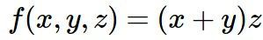
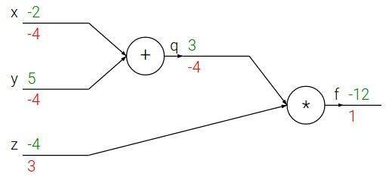
Backpropagation: a simple example
Reference: Stanford CS231n

Slide 12
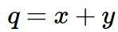
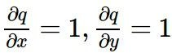
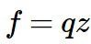
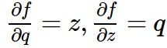
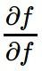
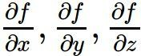
Backpropagation: a simple example
e.g. x = -2, y = 5, z = -4
1
Want:
Reference: Stanford CS231n

Slide 13
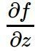
Backpropagation: a simple example
e.g. x = -2, y = 5, z = -4
1
3
Want:
Reference: Stanford CS231n

Slide 14
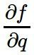
Backpropagation: a simple example
e.g. x = -2, y = 5, z = -4
-4
1
3
Want:
Reference: Stanford CS231n

Slide 15
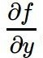
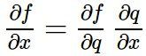
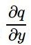
Backpropagation: a simple example
e.g. x = -2, y = 5, z = -4
-4
-4
1
3
Chain rule:
Want:
Upstream gradient
Local gradient
Reference: Stanford CS231n

Slide 16
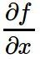
Backpropagation: a simple example
-4
e.g. x = -2, y = 5, z = -4
-4
-4
1
3
Chain rule:
Want:
Upstream gradient
Local gradient
Reference: Stanford CS231n

Slide 17
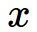
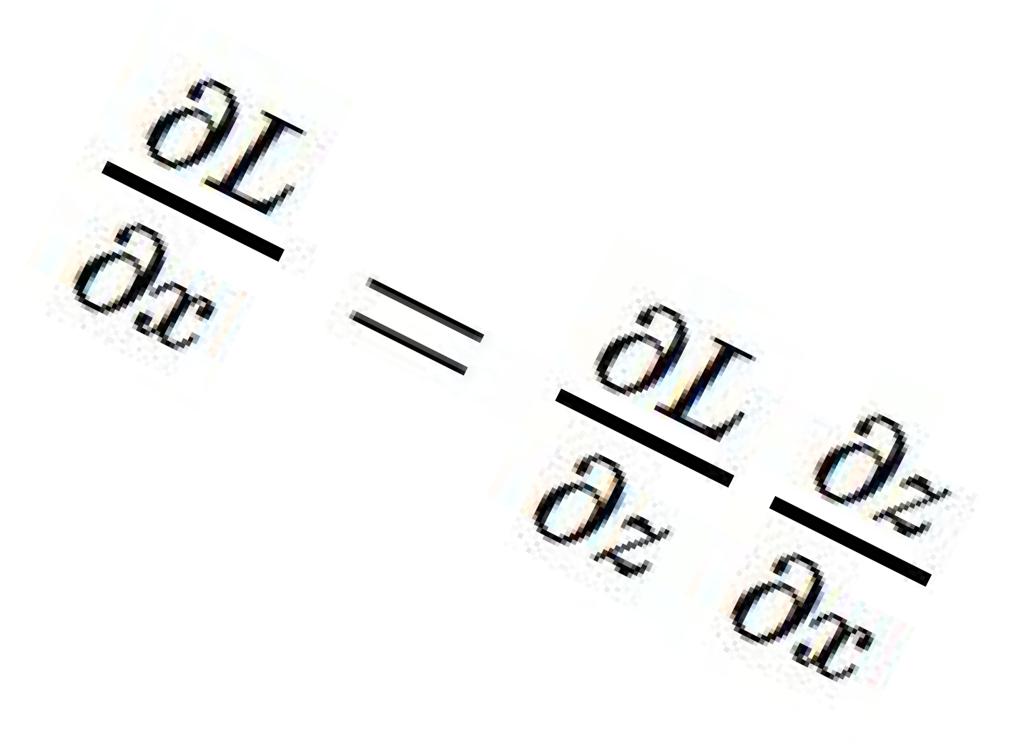
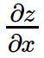
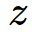
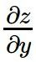
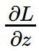
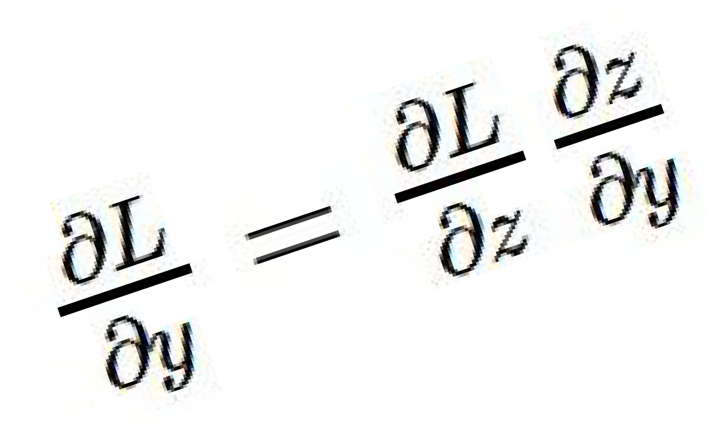
Backpropagation: a simple example
“local gradient”
f
“Downstream gradients”
“Upstream
gradient”

Slide 18
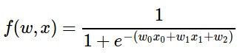

Another example

Slide 19
Another example

Slide 20


Another example

Slide 21
Another example
“local gradient”
“Downstream gradients”
f
“Upstream
gradient”

Slide 22

Another example
“local gradient”
“Downstream gradients”
f
“Upstream
gradient”
Upstream gradient
Local gradient

Slide 23
Another example
“local gradient”
“Downstream gradients”
f
“Upstream
gradient”

Slide 24
Another example
Upstream gradient
Local gradient

Slide 25
Another example
“local gradient”
“Downstream gradients”
f
“Upstream
gradient”

Slide 26
Another example
“local gradient”
“Downstream gradients”
f
“Upstream
gradient”
Upstream gradient
Local gradient

Slide 27
Another example
“local gradient”
“Downstream gradients”
f
“Upstream
gradient”

Slide 28
Another example
Upstream gradient
Local gradient

Slide 29
Another example
“local gradient”
“Downstream gradients”
f
“Upstream
gradient”

Slide 30
Another example
[upstream gradient] x [local gradient] [0.2] x [1] = 0.2
[0.2] x [1] = 0.2 (both inputs!)

Slide 31
Another example

Slide 32

Another example
[upstream gradient] x [local gradient] w0: [0.2] x [-1] = -0.2
x0: [0.2] x [2] = 0.4

Slide 33

Another example
Computational graph representation may not be unique. Choose one where local gradients at each node can be easily expressed!
Sigmoid function
Sigmoid
Sigmoid local gradient:

Slide 34
Another example
Computational graph representation may not be unique. Choose one where local gradients at each node can be easily expressed!
Sigmoid function
Sigmoid
[upstream gradient] x [local gradient] [1.00] x [(1 - 1/(1+e⁻¹)) (1/(1+e⁻¹))] = 0.2
Sigmoid local gradient:

Slide 35
Another example
Computational graph representation may not be unique. Choose one where local gradients at each node can be easily expressed!
Sigmoid function
Sigmoid
[upstream gradient] x [local gradient] [1.00] x [(1 - 0.73) (0.73)] = 0.2
Sigmoid local gradient:

Slide 36
Patterns in gradient flow
add gate: gradient distributor 3
mul gate: “swap multiplier” 2
2
4
7
5*3=15
3
6
+
×
2
5
2
copy gate: gradient adder
7
7
4+2=6
2*5=10
max gate: gradient router 4
4
7
0
5
5
max
9
2
9

Slide 37



Backprop implementation
Forward pass: Compute output
Backward pass: Compute grads
(Naïve) modular Implementation:
In each layer, store gradients of output z with respect to input x and parameters w.
During backprop, given upstream gradients, can easily compute downstream gradients using the stored values. Do this for each modular layer.

Slide 38
Backprop implementation
Forward pass: Compute output
Base case

Slide 39
Backprop implementation
Forward pass: Compute output
Sigmoid

Slide 40
Backprop implementation
Forward pass: Compute output
Add gate

Slide 41
Backprop implementation
Forward pass: Compute output
Add gate

Slide 42
Backprop implementation
Forward pass: Compute output
Multiply gate

Slide 43
Backprop implementation
Forward pass: Compute output
Multiply gate

Slide 44
So far: backprop with scalars
What about vector-valued functions?

Slide 45








Recap: Vector derivatives
Scalar to Scalar
Vector to Scalar
Vector to Vector
Regular derivative:
Derivative is Gradient:
Derivative is Jacobian:
If x changes by a small amount, how much will y change?
For each element of x, if it changes by a small amount then how much will y change?
For each element of x, if it changes by a small amount then how much will each element of y change?

Slide 46

Backprop with Vectors
Loss L still a scalar!
f

Slide 47
Backprop with Vectors
D_{x}
Loss L still a scalar!
D_{z}
f
D_{y}

Slide 48
Backprop with Vectors
D_{x}
Loss L still a scalar!
D_{z}
f
D_{y}
“Upstream gradient”

Slide 49
Backprop with Vectors
D_{x}
Loss L still a scalar!
D_{z}
f
D_{z}
D_{y}
“Upstream gradient” For each element of z, how much does it influence L?

Slide 50


Backprop with Vectors
D_{x}
Loss L still a scalar!
“local gradients”
D_{z}
f
“Downstream
gradients”
D_{z}
D_{y}
“Upstream gradient” For each element of z, how much does it influence L?

Slide 51
Backprop with Vectors
D_{x}
Loss L still a scalar!
“local gradients”
[D_{x} x D_{z}]
f
[D_{y} x D_{z}]
Jacobian matrices
D_{z}
“Downstream
gradients”
D_{z}
D_{y}
“Upstream gradient” For each element of z, how much does it influence L?

Slide 52
Backprop with Vectors
D_{x}
Loss L still a scalar!
“local gradients”
[D_{x} x D_{z}]
f
D_{x}
D_{z}
“Downstream
gradients”
Matrix-vector multiply
[D x D ]
D_{z}
D_{y}
y z
Jacobian matrices
“Upstream gradient” For each element of z, how much does it influence L?
D_{y}

Slide 53


Gradients of variables wrt loss have same dims as the original variable
Loss L still a scalar!
D_{x}
D_{x}
D_{z}
f
D_{z}
D_{y}
“Upstream gradient” For each element of z, how much does it influence L?
D_{y}

Slide 54
Backprop with Vectors
4D input x:
4D output z:
[ 1 ]
[ -2 ]
[ 3 ]
[ -1 ]
f(x) = max(0,x)
(elementwise)
[ 1 ]
[ 0 ]
[ 3 ]
[ 0 ]
Jacobian dz/dx [ 1 0 0 0 ]
[ 0 0 0 0 ]
[ 0 0 1 0 ]
4D dL/dz:
[ 4 ]
[ -1 ]
[ 5 ]
Upstream gradient
[ 0 0 0 0 ]
[ 9 ]

Slide 55
Backprop with Vectors
4D input x:
4D output z:
[ 1 ]
[ -2 ]
[ 3 ]
[ -1 ]
f(x) = max(0,x)
(elementwise)
[ 1 ]
[ 0 ]
[ 3 ]
[ 0 ]
Jacobian is sparse: off-diagonal entries always zero! Never explicitly form Jacobian -- instead use implicit multiplication
4D dL/dx: [ 4 ]
[ 0 ]
[ 5 ]
[ 0 ]
[dz/dx] [dL/dz] [ 1 0 0 0 ] [ 4 ]
[ 0 0 0 0 ] [ -1 ]
[ 0 0 1 0 ] [ 5 ]
[ 0 0 0 0 ] [ 9 ]
4D dL/dz:
[ 4 ]
[ -1 ]
[ 5 ]
[ 9 ]
Upstream gradient

Slide 56

Backprop with Vectors
4D input x:
4D output z:
[ 1 ]
[ -2 ]
[ 3 ]
[ -1 ]
f(x) = max(0,x)
(elementwise)
[ 1 ]
[ 0 ]
[ 3 ]
[ 0 ]
Jacobian is sparse: off-diagonal entries always zero! Never explicitly form Jacobian -- instead use implicit multiplication
4D dL/dx: [ 4 ]
[ 0 ]
[ 5 ]
[ 0 ]
[dz/dx] [dL/dz]
4D dL/dz:
[ 4 ]
[ -1 ]
[ 5 ]
[ 9 ]
z
Upstream gradient

Slide 57
Backprop with Matrices (or Tensors)
Loss L still a scalar!
[D_{x}×M_{x}]
dL/dx always has the same shape as x!
[D_{z}×M_{z}]
f
Jacobian matrices
Matrix-vector multiply
[D_{y}×M_{y}]

Slide 58


Backprop with Matrices (or Tensors)
Loss L still a scalar!
[D_{x}×M_{x}]
[D_{x}×M_{x}]
dL/dx always has the same shape as x!
[D_{z}×M_{z}]
f
Jacobian matrices
“Downstream
gradients”
Matrix-vector multiply
[D_{y}×M_{y}]
[D_{z}×M_{z}]
“Upstream gradient” For each element of z, how much does it influence L?
[D_{y}×M_{y}]

Slide 59

Backprop with Matrices (or Tensors)
Loss L still a scalar!
[D_{x}×M_{x}]
[D_{x}×M_{x}]
dL/dx always has the same shape as x!
[D_{z}×M_{z}]
“local gradients”
“Downstream
gradients”
Matrix-vector multiply
[D_{y}×M_{y}]
[D_{y}×M_{y}]
[D_{z}×M_{z}]
“Upstream gradient” For each element of z, how much does it influence L?
Jacobian matrices
For each element of y, how much does it influence each element of z?

Slide 60
Backprop with Matrices
Loss L still a scalar!
[D_{x}×M_{x}]
[D_{x}×M_{x}]
dL/dx always has the same shape as x!
“local gradients”
[(D_{x}×M_{x})×(D_{z}×M_{z})]
[D_{z}×M_{z}]
“Downstream
gradients”
Matrix-vector multiply
[(D_{y}×M_{y})×(D_{z}×M_{z})]
[D_{y}×M_{y}]
[D_{z}×M_{z}]
Jacobian matrices
“Upstream gradient” For each element of z, how much does it influence L?
[D_{y}×M_{y}]
For each element of y, how much does it influence each element of z?

Slide 61

Backprop with Matrices
y: [N×M]
[13 9 -2 -6 ]
[ 5 2 17 1 ]
x: [N×D]
Matrix Multiply
[ 2 1 -3 ]
[ -3 4 2 ]
dL/dy: [N×M] [ 2 3 -3 9 ]
[ -8 1 4 6 ]
w: [D×M]
[ | 3 | 2 | 1 -1]
[ | 2 | 1 | 3 2]
[ | 3 | 2 | 1 -2]
Jacobians: dy/dx: [(N×D)×(N×M)]
dy/dw: [(D×M)×(N×M)]
For a neural net we may have N=64, D=M=4096
Each Jacobian takes ~256 GB of memory! Must work with them implicitly!

Slide 62
Backprop with Matrices
y: [N×M]
[13 9 -2 -6 ]
[ 5 2 17 1 ]
x: [N×D]
Matrix Multiply
[ 2 1 -3 ]
[ -3 4 2 ]
dL/dy: [N×M] [ 2 3 -3 9 ]
[ -8 1 4 6 ]
w: [D×M]
[ 3 2 1 -1]
[ 2 1 3 2]
[ 3 2 1 -2]
Q: What parts of y are affected by one element of x?

Slide 63



Backprop with Matrices
y: [N×M]
[13 9 -2 -6 ]
[ 5 2 17 1 ]
x: [N×D]
Matrix Multiply
[ 2 1 -3 ]
[ -3 4 2 ]
dL/dy: [N×M] [ 2 3 -3 9 ]
[ -8 1 4 6 ]
w: [D×M]
[ 3 2 1 -1]
[ 2 1 3 2]
[ 3 2 1 -2]
Q: What parts of y are affected by one element of x?
A: affects the whole row

Slide 64

Backprop with Matrices
y: [N×M]
[13 9 -2 -6 ]
[ 5 2 17 1 ]
x: [N×D]
Matrix Multiply
[ 2 1 -3 ]
[ -3 4 2 ]
dL/dy: [N×M] [ 2 3 -3 9 ]
[ -8 1 4 6 ]
w: [D×M]
[ 3 2 1 -1]
[ 2 1 3 2]
[ 3 2 1 -2]
Q: What parts of y are affected by one element of x?
Q: How much
does
affect ?
A: affects the whole row

Slide 65


Backprop with Matrices
y: [N×M]
[13 9 -2 -6 ]
[ 5 2 17 1 ]
x: [N×D]
Matrix Multiply
[ 2 1 -3 ]
[ -3 4 2 ]
dL/dy: [N×M] [ 2 3 -3 9 ]
[ -8 1 4 6 ]
w: [D×M]
[ 3 2 1 -1]
[ 2 1 3 2]
[ 3 2 1 -2]
Q: What parts of y are affected by one element of x?
Q: How much
does
affect ?
A: affects the
A:
whole row

Slide 66

Backprop with Matrices
y: [N×M]
[13 9 -2 -6 ]
[ 5 2 17 1 ]
x: [N×D]
Matrix Multiply
[ 2 1 -3 ]
[ -3 4 2 ]
dL/dy: [N×M] [ 2 3 -3 9 ]
[ -8 1 4 6 ]
w: [D×M]
[ 3 2 1 -1]
[ 2 1 3 2]
[ 3 2 1 -2]
Q: What parts of y are affected by one element of x?
Q: How much
does
affect ?
A: affects the
A:
[N×D] [N×M] [M×D]
whole row

Slide 67

Backprop with Matrices
y: [N×M]
[13 9 -2 -6 ]
[ 5 2 17 1 ]
x: [N×D]
Matrix Multiply
[ 2 1 -3 ]
[ -3 4 2 ]
dL/dy: [N×M] [ 2 3 -3 9 ]
[ -8 1 4 6 ]
w: [D×M]
[ 3 2 1 -1]
[ 2 1 3 2]
[ 3 2 1 -2]
By similar logic:
[N×D] [N×M] [M×D]
[D×M] [D×N] [N×M]
These formulas are easy to remember: they are the only way to make shapes match up!
Storage / Memory comparison:
The naïve approach: store the intermediate Jacobian matrix:
The efficient approach:
dy/dx: [(N×D)×(N×M)]
dy/dw: [(D×M)×(N×M)]
dL/dx: (M×D), only store w^T
dy/dw: (D×N), only store x^T

Slide 68
Backprop with Matrices
1. Previous naïve modular Implementation:
In each layer, store gradients of output z with respect to input x and parameters w (i.e., store the Jacobian matrices).
During backprop, given upstream gradients, can easily compute downstream gradients using the stored values. Do this for each modular layer.
Memory inefficient
2. Improved modular Implementation:
In each layer, store input x and parameters w.
During backprop, given upstream gradients, can easily compute downstream gradients using the stored values. Do this for each modular layer.
Memory efficient
[N×D] [N×M] [M×D]
[D×M] [D×N] [N×M]

